Slide 1
Epam DevOps practice. Project
Created by Kolomiiets Dmytro

Slide 2
Description of the project
For the project was used to EC2 and VPC services.
Project describe installing web server on other virtual machine which should be launched by terraform and configured by ansible.
All was managed by Jenkins.
Jenkins get to info about push in the remote github repository thanks to GitHub WebHook and automatically start to pipeline.

Slide 3
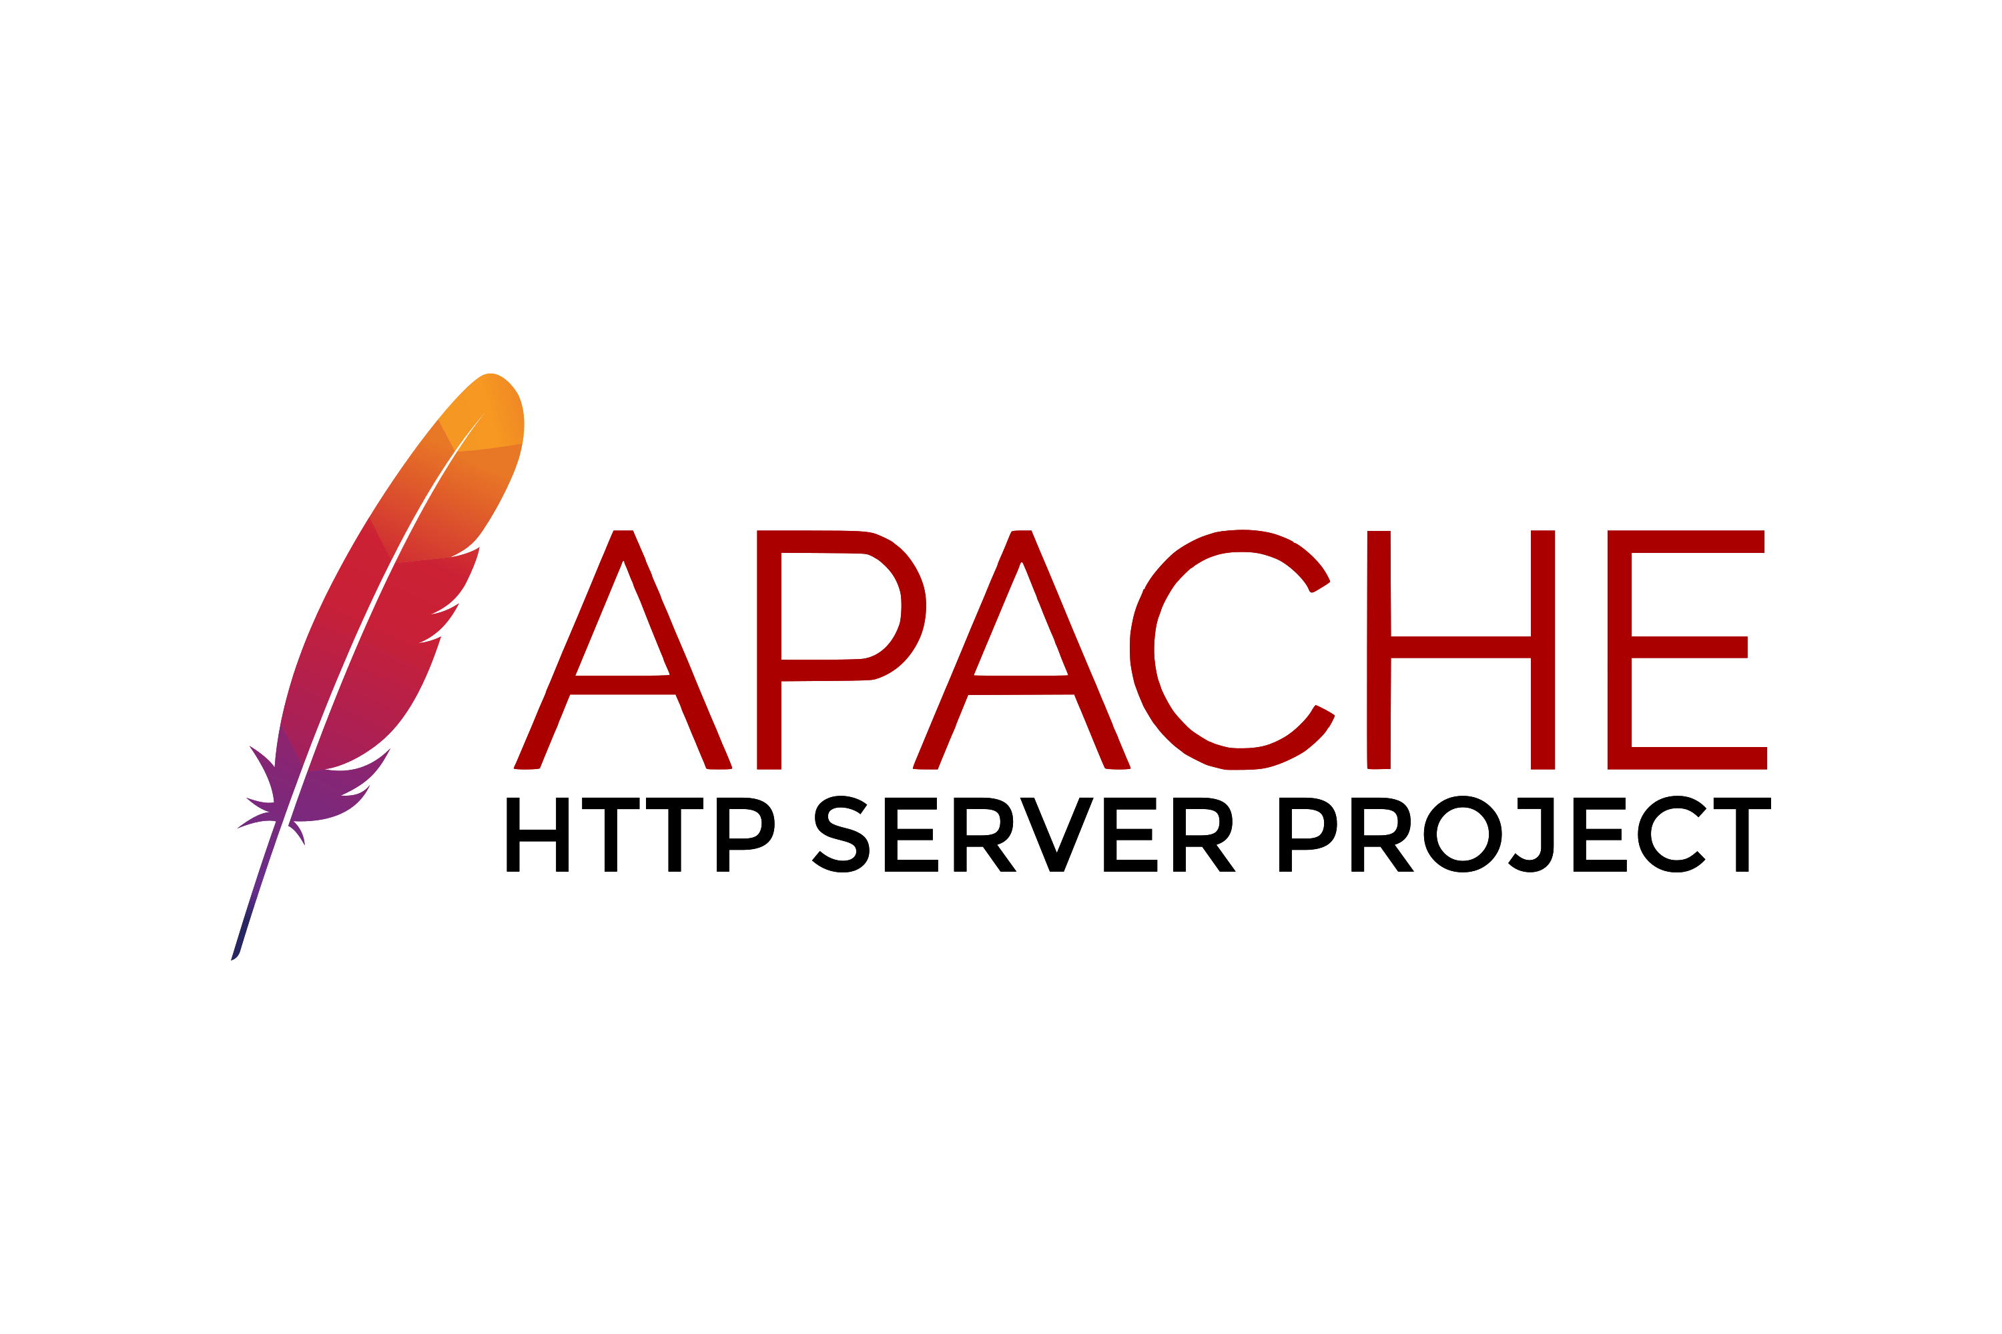



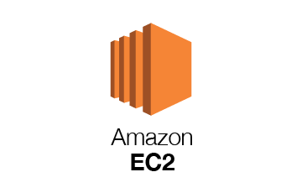



Project scheme
Web page
Using GitHub WebHook
Third step, installing apache2 and configure it by ansible
Second step, 30 seconds for waiting initialization and get additional info about VM
First step, installing new VM by terraform

Slide 4
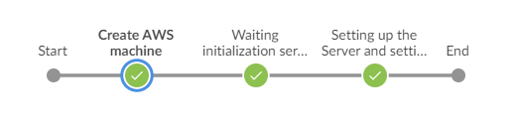
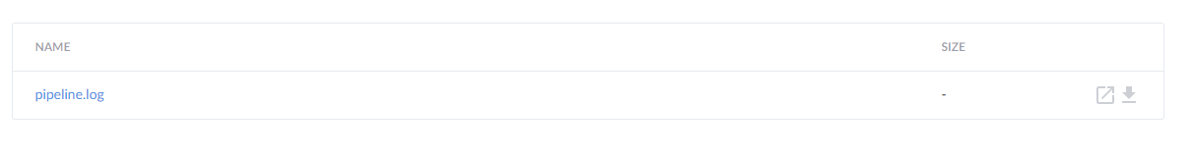
Working example of the project
In the picture you can see all steps on the pipeline:
Into artifacts I got one .log file:

Slide 5
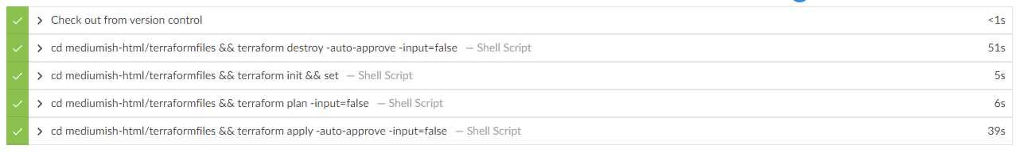
The first step in the pipeline
In this step I was opening folders into local repository and initialize VM by terraform. Was used commands:
Destroy – it is a way to destroy all remote objects managed by a particular terraform configuration.
Init and set (for checking shell environment) – to initialize a working directory containing terraform configuration files.
Plan – creates an execution plan. It also shows all the options.
Apply - command executes the actions proposed in a terraform plan.

Slide 6
The second step in the pipeline
At this step, I was waiting 30 seconds for the virtual machine to initialize. Then I set the rights to read the ssh key. Finally, I look at the characteristics of the new virtual machine.

Slide 7
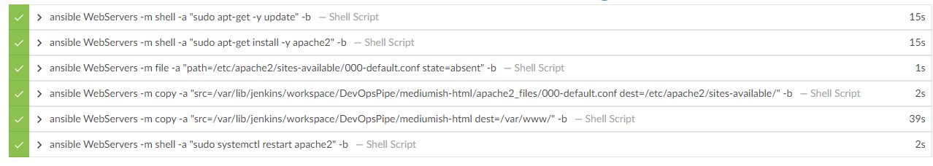
The third step in the pipeline
At this step was configured new VM only by an ansible. Firstly, was used usual shell commands for execute several scripts. Secondly, I deleted apache2 .conf file and copied it from the local repository. Finally, I copied all .html, .css, .js, .img files on the working directory.

